Slide 1




Using Physics to Corroborate Detected SCADA Host Attacks
Moses Ike
Ph.D. Candidate under Prof. Wenke Lee and Prof. Saman Zonouz
Georgia Institute of Technology
January 10, 2023

Slide 2







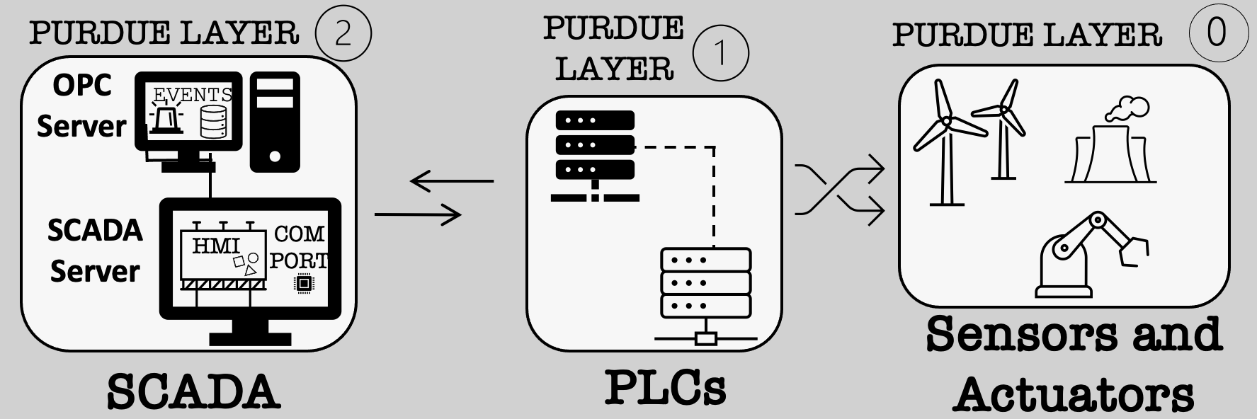
Industrial Control Systems (ICS) Operational Technology (OT) Cyber-Physical Systems (CPS)
BACKGROUND
Water Treatment Plants
Power Substations
Nuclear Plants
Programmable Logic Controllers (PLC)
Supervisory Control and Data Acquisition (SCADA) Systems
The Purdue ICS Network Architecture
Notes:
ICS generally describe non-traditional systems that perform physical work in industrial processes such as water treatment plants, power stations and nuclear plants.
In contrasts to (IT) applications ICS are Cyber-Physical Systems and used in operational technology applications. (or OT)
In the field, programmable logic controllers (or PLC) continuously read sensor values and used that to drive actuators.
In ICS control centers, Supervisory Control and Data Acquisitions systems (or SCADA) read physical measurements from devices, and if needed send out control commands to the devices.
Operators can also use SCADA human machine interfaces or HMI to manually operate devices.
SCADA run special software programs to guide a physical process to achieving its setpoint goal. This is known as process-control
On the slide, I show our SCADA, PLCs, sensor and actuators are deployed on the network.
1:07

Slide 3
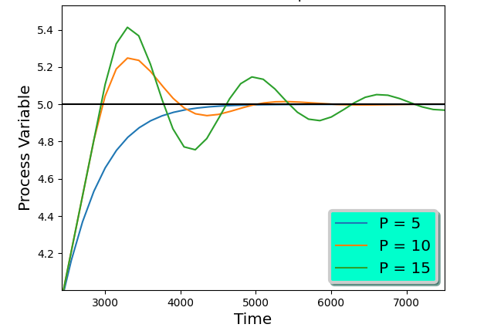
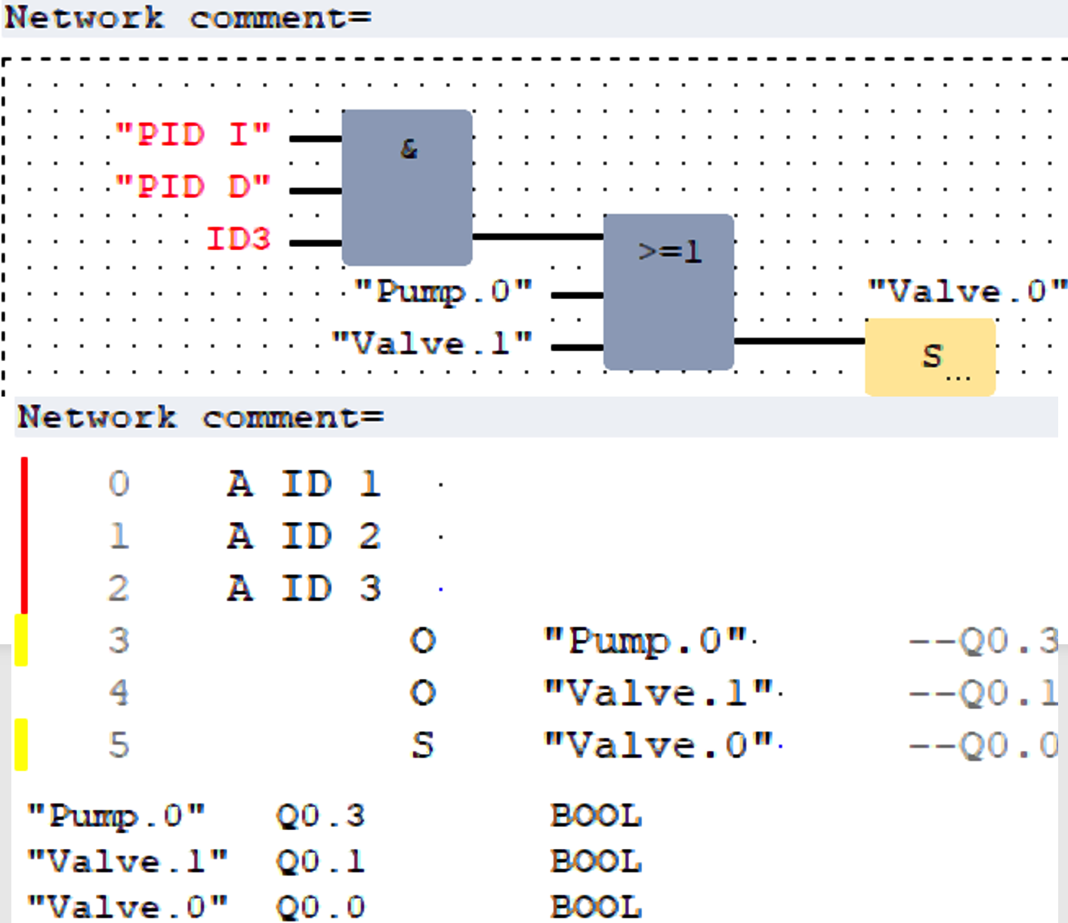
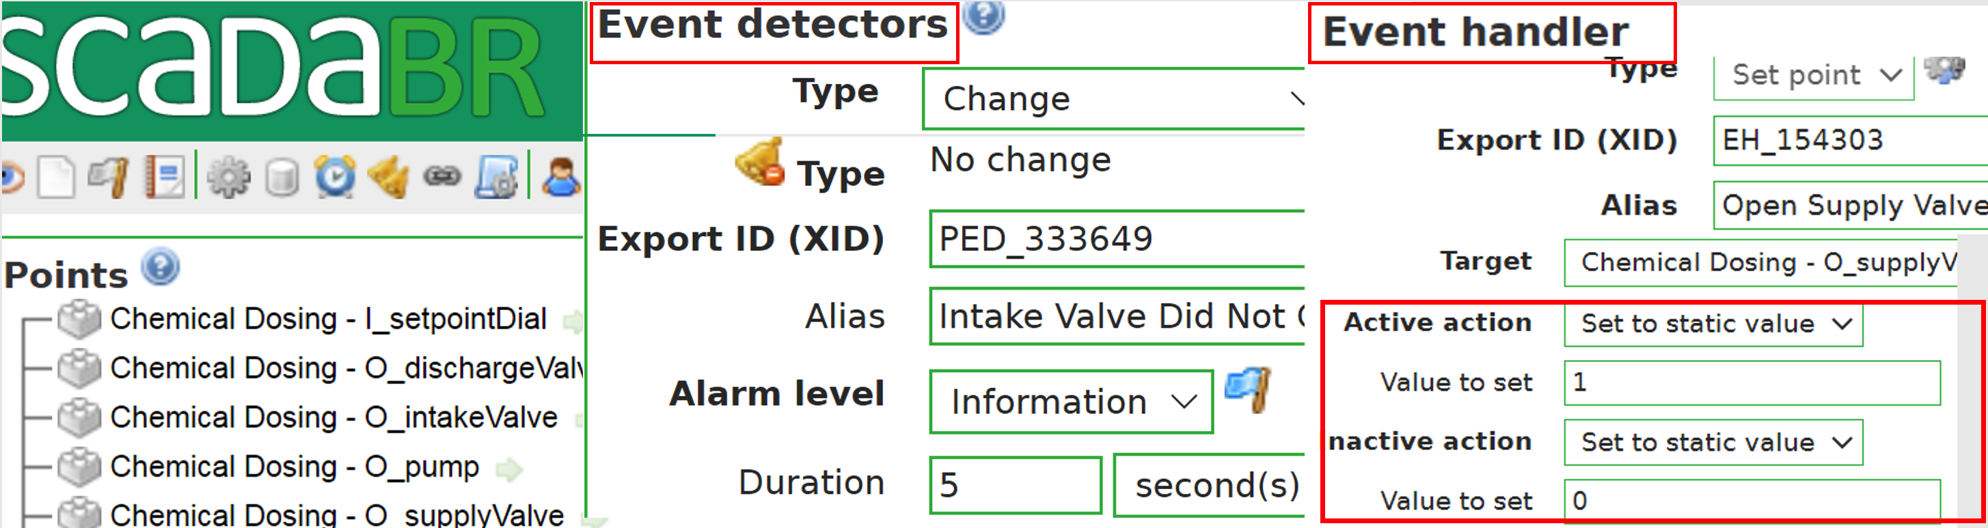
Basic Control ~1 - 10ms (done by PLCs)
(Control) Cause and (Physical) Effect
Unlike IT, OT has Cause and Physical Effect
Control inputs result in physical actuation
Control inputs are generated by a software logic
Physical actuation are governed by the ”Physics” of devices (physical process), and measured by sensors
Setpoint
Reached
Changing
Tank Level
Two (2) Types of Control
Supervisory Control
~1000ms (done by SCADA)
Supervisory Control and Data Acquisition (SCADA) Systems
Programmable Logic Controllers (PLC)
Notes:
ICS generally describe non-traditional systems that perform physical work in industrial processes such as water treatment plants, power stations and nuclear plants.
In contrasts to (IT) applications ICS are Cyber-Physical Systems and used in operational technology applications. (or OT)
In the field, programmable logic controllers (or PLC) continuously read sensor values and used that to drive actuators.
In ICS control centers, Supervisory Control and Data Acquisitions systems (or SCADA) read physical measurements from devices, and if needed send out control commands to the devices.
Operators can also use SCADA human machine interfaces or HMI to manually operate devices.
SCADA run special software programs to guide a physical process to achieving its setpoint goal. This is known as process-control
On the slide, I show our SCADA, PLCs, sensor and actuators are deployed on the network.
1:07

Slide 4
Modern ICS is no longer “air-gapped”…. prone to cyber infection
THREAT MODEL (We assume SCADA is compromised)
SCADA connects to the IT network and internet, utilizes cyber resources
Modern attacks infect SCADA to disrupt physical processes
A note on SCADA Analysis
Network Traffic vs. Host Execution
THREAT MODEL
SCADA is compromised or Attacker resides in the SCADA Systems, and aims to cause physical disruption or damages
Notes:
Traditionally, ICS is air-gapped, but not anymore because SCADA now connects to the IT network. This makes them vulnerable to cyber infections, which can come from files inputs, network, and malicious programs.
SCADA works by responding to events in the plant, and send out control commands. For example, in the power grid, SCADA systems send setpoints controls to generators to optimize power flow. Unfortunately, attackers, after infecting a SCADA hosts , can send attack commands to disrupt physical processes.
35 sec

Slide 5


Vast Majority of Past ICS Attacks were launched from SCADA hosts
Comparing Past Attack Host Behaviors
2010
Iran Nuclear Plant
Centrifuge Sabotage
2016
Ukrainian PowerGrid
Blackout
2021
City of Oldsmar
Water Poisoning
 | STUXNET | Industroyer | Oldsmar
Access to SCADA COM Ports | Exploits SCADA Programs | Terminates SCADA Programs | Uses HMI to control SCADA
Stealth Level | High | Low | Medium
Custom APIs | YES | YES | NO
Physical Attack | Modifies PLC Logic | Control Commands | Control Commands
STUXNET
INDUSTROYER
OLDSMAR
Notes:
The vast majority of past ICS attacks were launched from infected SCADA hosts. Just show case some examples, in 2010, a malware called Stuxnet infected Siemens SCADA host in the Iran Nuclear plants, and reprogrammed PLCs to damage a total of 900 centrifuges over several months. In 2016, another malware, Industroyer Infected SCADA systems in the Ukrainian power grid, and disruptec circuit breakers, which caused blackouts. As recent as 2021, a attacker used the HMI in the city of Oldsmar, FL, to send command to poison the water treatment processes of the city.
Modern attacks, such as the 2 above, are semantic-based, what that means is that they can maintain normal host and network conditions, which disrupting the processes.
43 sec

Slide 6
Limitations of Existing ICS Defenses
Physical Measurements: Flag anomalous sensor readings at runtime. First learns the normal “Physics” of the ICS process
High false alarms due to benign physical noise, faults, and errors
Cannot validate flagged anomalies
PLC Defenses: Prevent PLC logic/code modification
A SCADA adversary can modify PLC I/Os without touching its logic
Host-based (SCADA): Flag anomalous host API calls at runtime
Attackers also use normal tools/API calls. Requires knowledge of operational events or what triggers SCADA
Cannot know if anomalous APIs cause negative physical effects
Our Insight: Correlate cause and effect via SCADA-Physics Anomaly Correlation
Start from SCADA, where the attack is launched from, and find anomalies
Then use Physics to corroborate (or filter) detected SCADA anomalies
Notes:
To detect ICS attacks, existing defenses can be grouped into sensor-based, PLC-based, and host-based. Sensor-based tools are the most popular, and they work by learning normal sensor readings, such as using machine learning or physical equations, and then flag anomalous values at runtime. However, they raise high false alarms due to benign anomalies such as noise, faults, and errors.
False alarms are costly in OT, because apart from causing operator fatigue, since they may have to travel to the field to check out the alarms, false alarms can also lead to the shutdown of the plant, which may disrupt essential life services like electricity.
PLC defense can detect modified PLC logic. However, a SCADA adversary can modify PLC I/O at runtime to disrupt devices without touching the logic
Host-based defense can flag anomalous or non-SCADA Api calls. However, modern attacks can use normal APIs to perform their attacks.
In general, existing tools perform their analysis in isolation and hence lack additional context to validate their findings. For example, when sensor tools detect physical anomalies, they don’t have a way to know if it is an actual attack from SCADA, which can be helpful to rule out false alarms such as benign mal-function. The inability to do this is due to the semantic gap between SCADA execution and their physical world sensor effects.
(ADDED)
1:40

Slide 7
SCADA-Physics Anomaly Correlation: Summary/Roadmap
SCADA Host Analysis
Use SCADA operational events to Induce SCADA “Physical-bound” API Calls
Analyze their statistical (Frequency and Timing) dependencies. Model SCADA operational semantics
Physics Analysis
Use sequence-based neural network to learn normal sensor/actuator time series
Apply Transformer-based Autoencoders to rank important physics relationships
Leverage “Inertia” to inform effect neural network sequence length.
SCADA-Physics Correlation
Align the anomaly correlation time-window (i.e., Physics lag behind SCADA due to inertia)
Anomalies that show up at both behaviors, is a strong indicator of an actual attack
In practice, we use Physics anomalies to filter or corroborate SCADA anomalies
False positives: Physics anomalies that permeate from previous time windows before SCADA anomaly
Notes:
To detect ICS attacks, existing defenses can be grouped into sensor-based, PLC-based, and host-based. Sensor-based tools are the most popular, and they work by learning normal sensor readings, such as using machine learning or physical equations, and then flag anomalous values at runtime. However, they raise high false alarms due to benign anomalies such as noise, faults, and errors.
False alarms are costly in OT, because apart from causing operator fatigue, since they may have to travel to the field to check out the alarms, false alarms can also lead to the shutdown of the plant, which may disrupt essential life services like electricity.
PLC defense can detect modified PLC logic. However, a SCADA adversary can modify PLC I/O at runtime to disrupt devices without touching the logic
Host-based defense can flag anomalous or non-SCADA Api calls. However, modern attacks can use normal APIs to perform their attacks.
In general, existing tools perform their analysis in isolation and hence lack additional context to validate their findings. For example, when sensor tools detect physical anomalies, they don’t have a way to know if it is an actual attack from SCADA, which can be helpful to rule out false alarms such as benign mal-function. The inability to do this is due to the semantic gap between SCADA execution and their physical world sensor effects.
(ADDED)
1:40

Slide 8
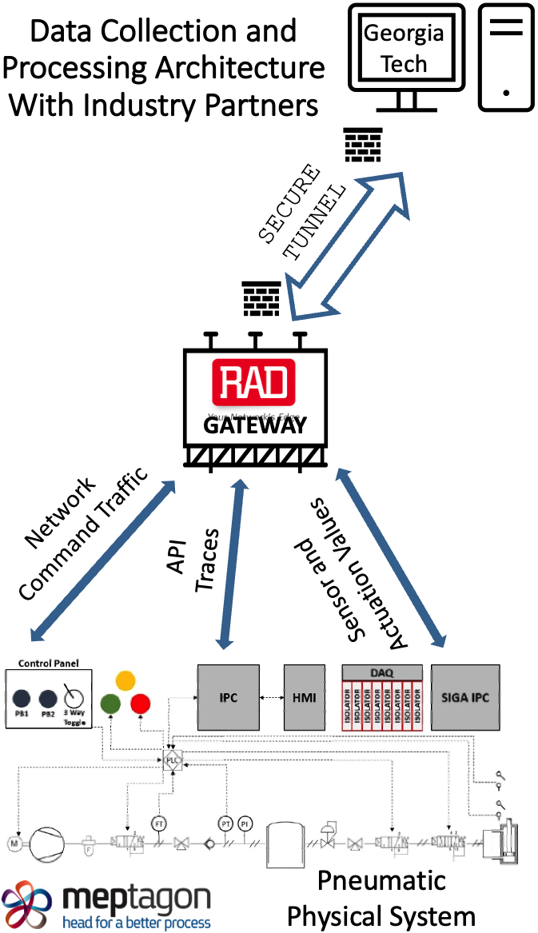
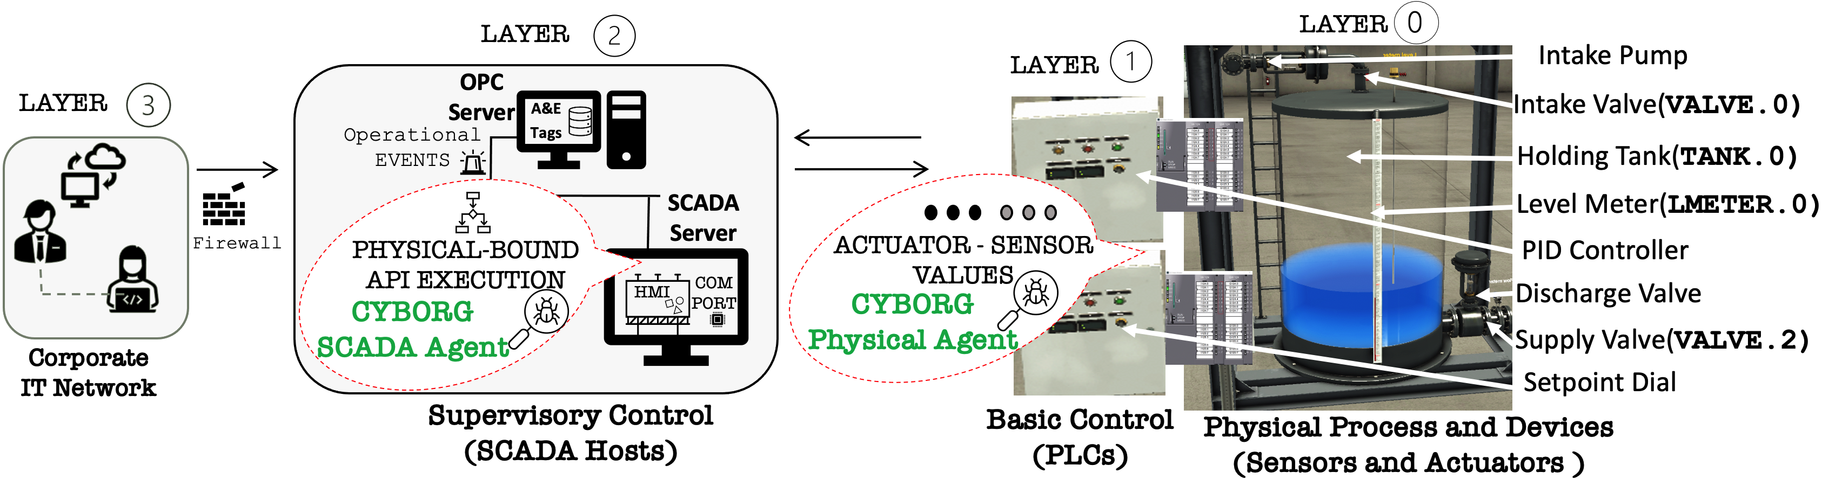
SCADA-Physics Anomaly Correlation: Example Deployment
ScadaBR
OpenPLC
FactoryIO
Tools used in our test environment
Notes:
To detect ICS attacks, existing defenses can be grouped into sensor-based, PLC-based, and host-based. Sensor-based tools are the most popular, and they work by learning normal sensor readings, such as using machine learning or physical equations, and then flag anomalous values at runtime. However, they raise high false alarms due to benign anomalies such as noise, faults, and errors.
False alarms are costly in OT, because apart from causing operator fatigue, since they may have to travel to the field to check out the alarms, false alarms can also lead to the shutdown of the plant, which may disrupt essential life services like electricity.
PLC defense can detect modified PLC logic. However, a SCADA adversary can modify PLC I/O at runtime to disrupt devices without touching the logic
Host-based defense can flag anomalous or non-SCADA Api calls. However, modern attacks can use normal APIs to perform their attacks.
In general, existing tools perform their analysis in isolation and hence lack additional context to validate their findings. For example, when sensor tools detect physical anomalies, they don’t have a way to know if it is an actual attack from SCADA, which can be helpful to rule out false alarms such as benign mal-function. The inability to do this is due to the semantic gap between SCADA execution and their physical world sensor effects.
(ADDED)
1:40

Slide 9
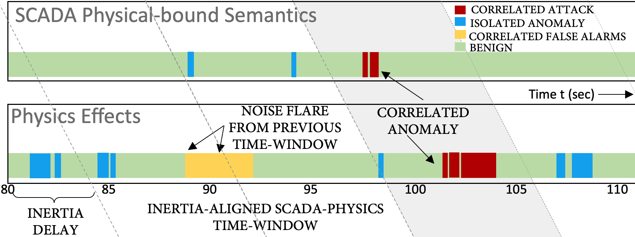
SCADA-Physics Anomaly Correlation
Notes:
To detect ICS attacks, existing defenses can be grouped into sensor-based, PLC-based, and host-based. Sensor-based tools are the most popular, and they work by learning normal sensor readings, such as using machine learning or physical equations, and then flag anomalous values at runtime. However, they raise high false alarms due to benign anomalies such as noise, faults, and errors.
False alarms are costly in OT, because apart from causing operator fatigue, since they may have to travel to the field to check out the alarms, false alarms can also lead to the shutdown of the plant, which may disrupt essential life services like electricity.
PLC defense can detect modified PLC logic. However, a SCADA adversary can modify PLC I/O at runtime to disrupt devices without touching the logic
Host-based defense can flag anomalous or non-SCADA Api calls. However, modern attacks can use normal APIs to perform their attacks.
In general, existing tools perform their analysis in isolation and hence lack additional context to validate their findings. For example, when sensor tools detect physical anomalies, they don’t have a way to know if it is an actual attack from SCADA, which can be helpful to rule out false alarms such as benign mal-function. The inability to do this is due to the semantic gap between SCADA execution and their physical world sensor effects.
(ADDED)
1:40

Slide 10
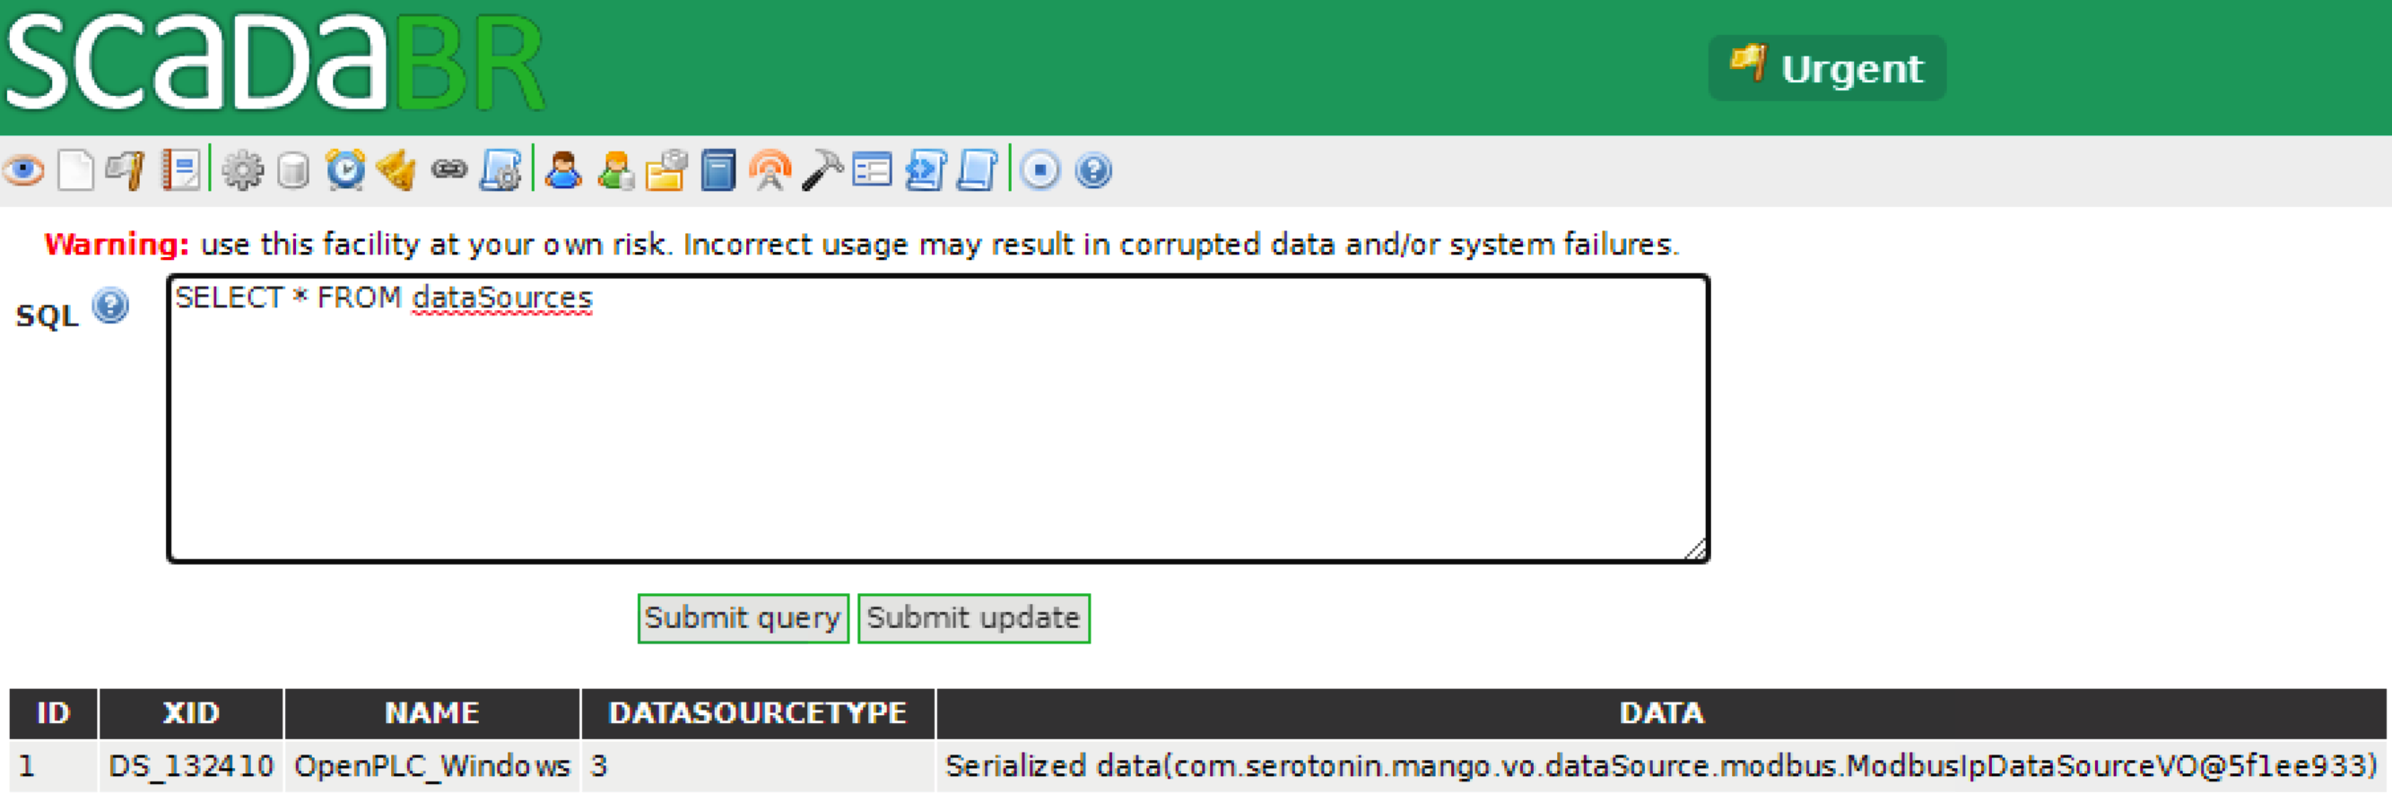
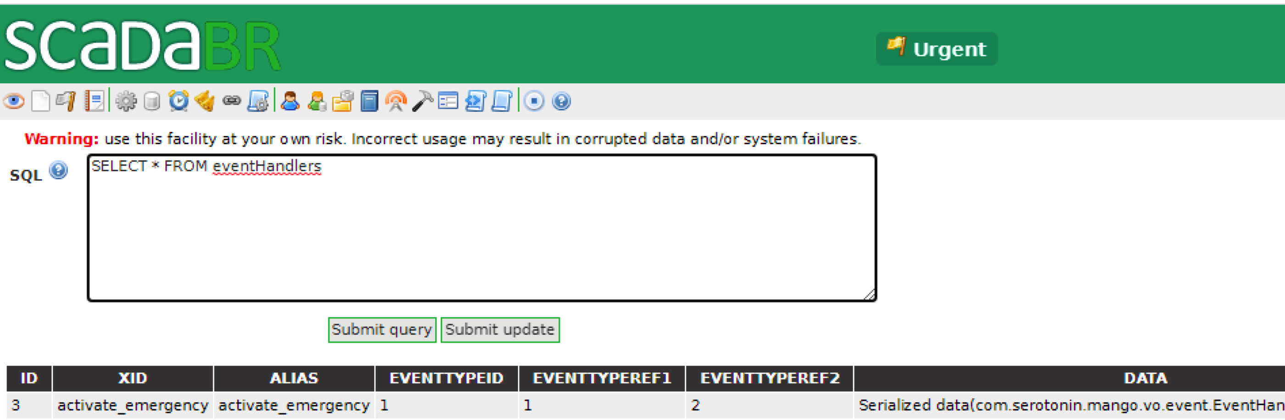
SCADA Operation in ScadaBR
View Connected PLCs
View Configured Events and Event Handlers
Notes:
To detect ICS attacks, existing defenses can be grouped into sensor-based, PLC-based, and host-based. Sensor-based tools are the most popular, and they work by learning normal sensor readings, such as using machine learning or physical equations, and then flag anomalous values at runtime. However, they raise high false alarms due to benign anomalies such as noise, faults, and errors.
False alarms are costly in OT, because apart from causing operator fatigue, since they may have to travel to the field to check out the alarms, false alarms can also lead to the shutdown of the plant, which may disrupt essential life services like electricity.
PLC defense can detect modified PLC logic. However, a SCADA adversary can modify PLC I/O at runtime to disrupt devices without touching the logic
Host-based defense can flag anomalous or non-SCADA Api calls. However, modern attacks can use normal APIs to perform their attacks.
In general, existing tools perform their analysis in isolation and hence lack additional context to validate their findings. For example, when sensor tools detect physical anomalies, they don’t have a way to know if it is an actual attack from SCADA, which can be helpful to rule out false alarms such as benign mal-function. The inability to do this is due to the semantic gap between SCADA execution and their physical world sensor effects.
(ADDED)
1:40

Slide 11
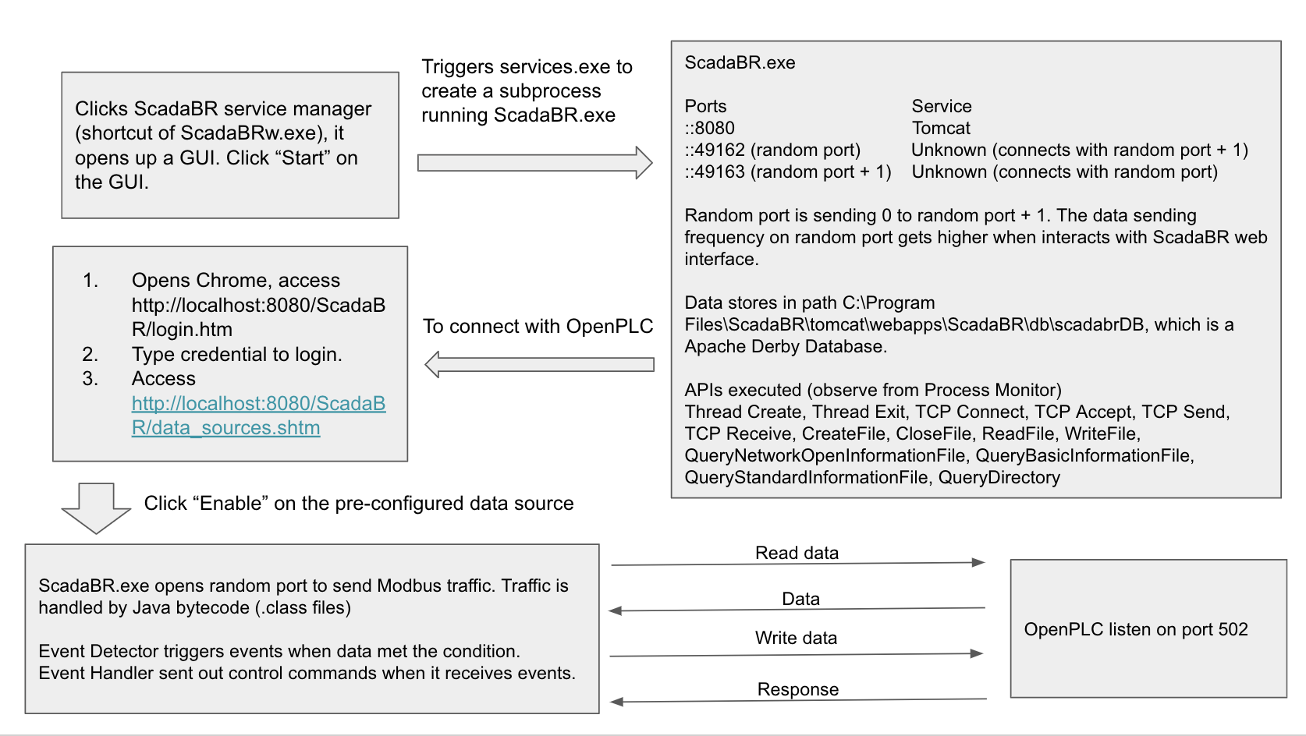
Analysis of SCADA Host Execution
Analyze “Physical-bound” API calls (not all API calls)
API call execution used to control the physical world
Must first identify the appropriate SCADA software process (done once)
Dissecting SCADA Internal Host Interactions
(Note that every SCADA System will be different)
Notes:
To detect ICS attacks, existing defenses can be grouped into sensor-based, PLC-based, and host-based. Sensor-based tools are the most popular, and they work by learning normal sensor readings, such as using machine learning or physical equations, and then flag anomalous values at runtime. However, they raise high false alarms due to benign anomalies such as noise, faults, and errors.
False alarms are costly in OT, because apart from causing operator fatigue, since they may have to travel to the field to check out the alarms, false alarms can also lead to the shutdown of the plant, which may disrupt essential life services like electricity.
PLC defense can detect modified PLC logic. However, a SCADA adversary can modify PLC I/O at runtime to disrupt devices without touching the logic
Host-based defense can flag anomalous or non-SCADA Api calls. However, modern attacks can use normal APIs to perform their attacks.
In general, existing tools perform their analysis in isolation and hence lack additional context to validate their findings. For example, when sensor tools detect physical anomalies, they don’t have a way to know if it is an actual attack from SCADA, which can be helpful to rule out false alarms such as benign mal-function. The inability to do this is due to the semantic gap between SCADA execution and their physical world sensor effects.
(ADDED)
1:40

Slide 12
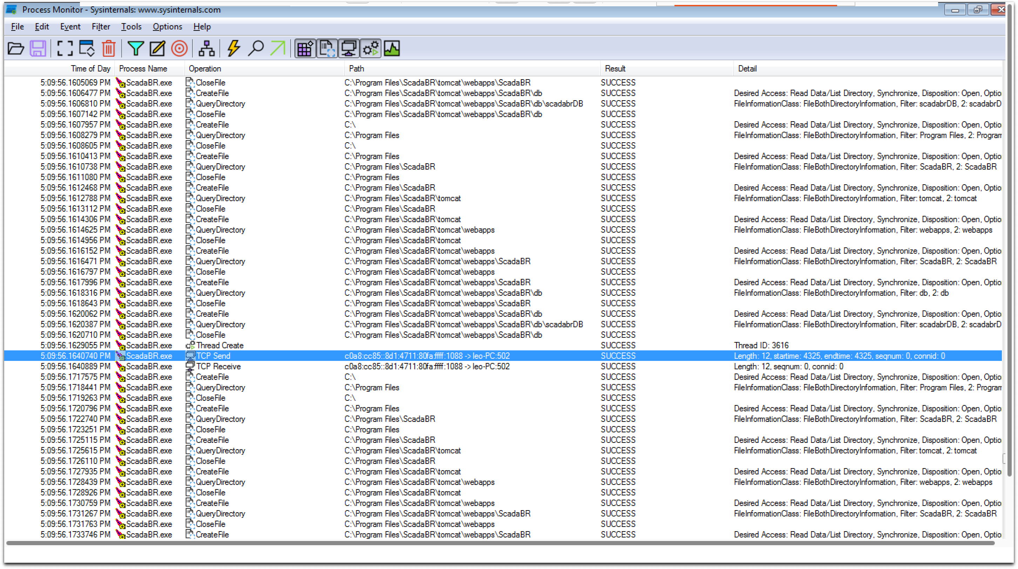
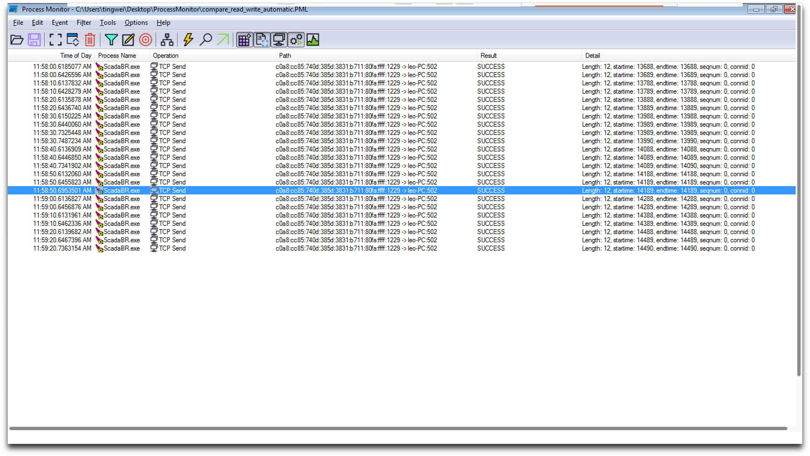
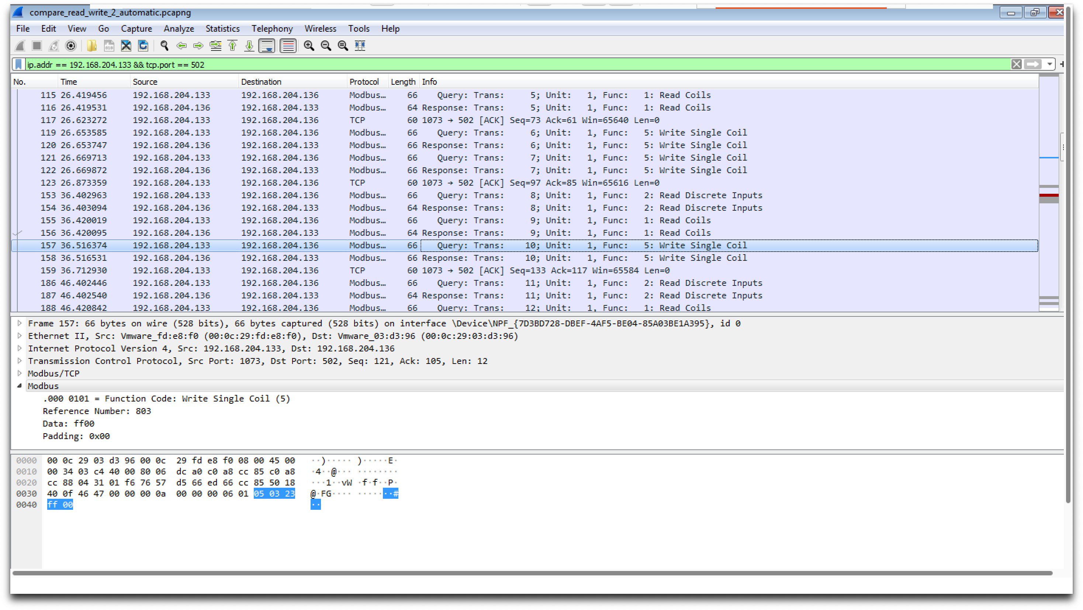
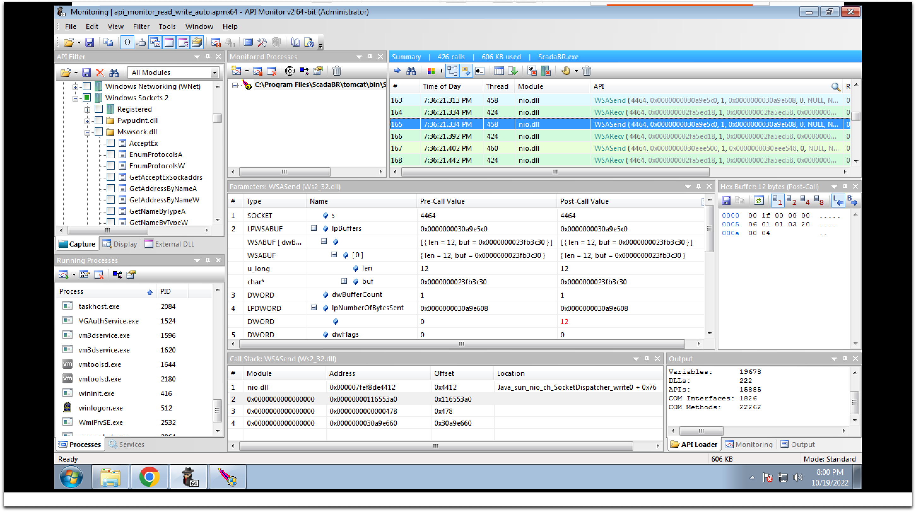
Analysis of SCADA Host Execution
ProcMon
ProcMon
Wireshark
API Mon
Notes:
To detect ICS attacks, existing defenses can be grouped into sensor-based, PLC-based, and host-based. Sensor-based tools are the most popular, and they work by learning normal sensor readings, such as using machine learning or physical equations, and then flag anomalous values at runtime. However, they raise high false alarms due to benign anomalies such as noise, faults, and errors.
False alarms are costly in OT, because apart from causing operator fatigue, since they may have to travel to the field to check out the alarms, false alarms can also lead to the shutdown of the plant, which may disrupt essential life services like electricity.
PLC defense can detect modified PLC logic. However, a SCADA adversary can modify PLC I/O at runtime to disrupt devices without touching the logic
Host-based defense can flag anomalous or non-SCADA Api calls. However, modern attacks can use normal APIs to perform their attacks.
In general, existing tools perform their analysis in isolation and hence lack additional context to validate their findings. For example, when sensor tools detect physical anomalies, they don’t have a way to know if it is an actual attack from SCADA, which can be helpful to rule out false alarms such as benign mal-function. The inability to do this is due to the semantic gap between SCADA execution and their physical world sensor effects.
(ADDED)
1:40

Slide 13
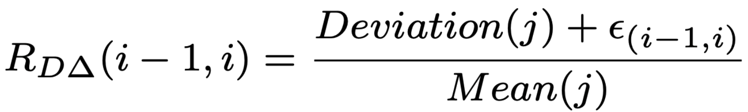
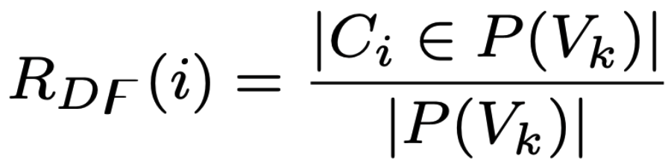
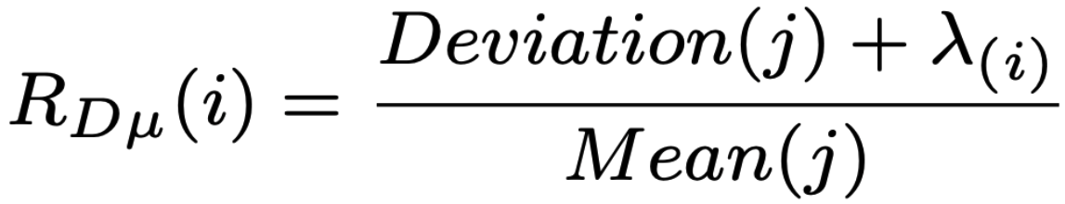
Statistical Analysis of SCADA Physical-bound API Calls
Formulation of Frequency and Timing Dependencies: Algorithm Development
Control Command Dependency
Control Time-Interval
Control Frequency
Control Burst-Interval
Notes:
To detect ICS attacks, existing defenses can be grouped into sensor-based, PLC-based, and host-based. Sensor-based tools are the most popular, and they work by learning normal sensor readings, such as using machine learning or physical equations, and then flag anomalous values at runtime. However, they raise high false alarms due to benign anomalies such as noise, faults, and errors.
False alarms are costly in OT, because apart from causing operator fatigue, since they may have to travel to the field to check out the alarms, false alarms can also lead to the shutdown of the plant, which may disrupt essential life services like electricity.
PLC defense can detect modified PLC logic. However, a SCADA adversary can modify PLC I/O at runtime to disrupt devices without touching the logic
Host-based defense can flag anomalous or non-SCADA Api calls. However, modern attacks can use normal APIs to perform their attacks.
In general, existing tools perform their analysis in isolation and hence lack additional context to validate their findings. For example, when sensor tools detect physical anomalies, they don’t have a way to know if it is an actual attack from SCADA, which can be helpful to rule out false alarms such as benign mal-function. The inability to do this is due to the semantic gap between SCADA execution and their physical world sensor effects.
(ADDED)
1:40

Slide 14


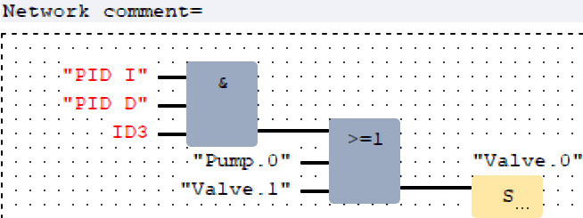
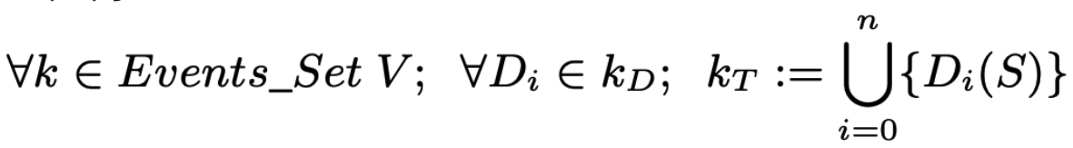

Inducing SCADA Events
Operational Events are configured in OPC Alarm&Event databases
Extract all configured events and device parameters
Statically parse the Function Block Diagram of the process to extract all dependent device states
Union all event states and inject into ScadaBR iteratively
Notes:
To detect ICS attacks, existing defenses can be grouped into sensor-based, PLC-based, and host-based. Sensor-based tools are the most popular, and they work by learning normal sensor readings, such as using machine learning or physical equations, and then flag anomalous values at runtime. However, they raise high false alarms due to benign anomalies such as noise, faults, and errors.
False alarms are costly in OT, because apart from causing operator fatigue, since they may have to travel to the field to check out the alarms, false alarms can also lead to the shutdown of the plant, which may disrupt essential life services like electricity.
PLC defense can detect modified PLC logic. However, a SCADA adversary can modify PLC I/O at runtime to disrupt devices without touching the logic
Host-based defense can flag anomalous or non-SCADA Api calls. However, modern attacks can use normal APIs to perform their attacks.
In general, existing tools perform their analysis in isolation and hence lack additional context to validate their findings. For example, when sensor tools detect physical anomalies, they don’t have a way to know if it is an actual attack from SCADA, which can be helpful to rule out false alarms such as benign mal-function. The inability to do this is due to the semantic gap between SCADA execution and their physical world sensor effects.
(ADDED)
1:40

Slide 15
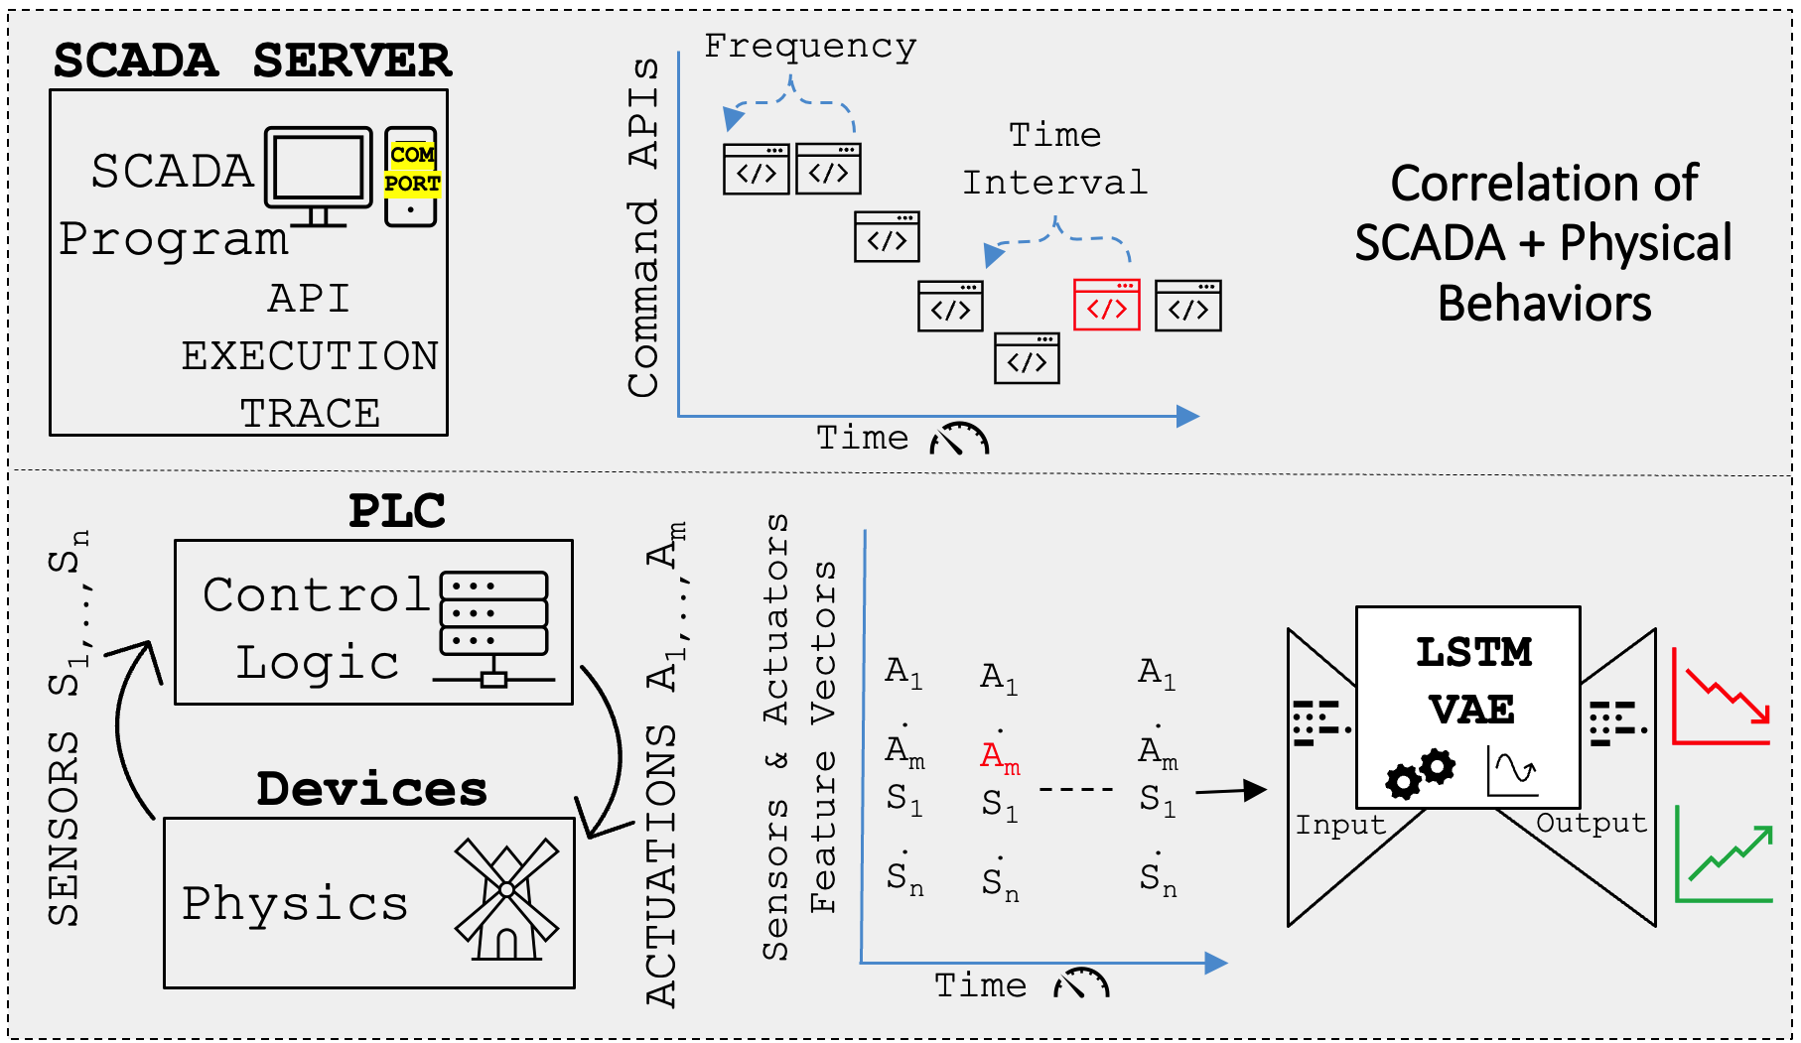
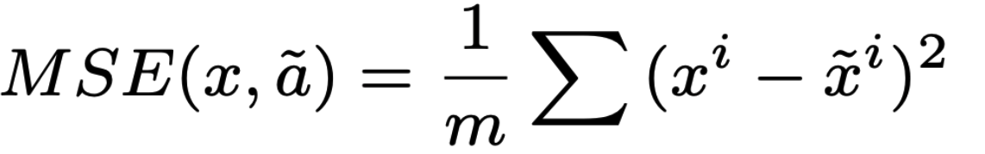
Physics Analysis
Learning normal sensor and actuator time series
Autoencoder
Error Re-construction
Actuator and Sensor time slice may not be causally related
Actuators are periodic in nature and not polled at same exact times, e.g., rising edge or peak values
Notes:
To detect ICS attacks, existing defenses can be grouped into sensor-based, PLC-based, and host-based. Sensor-based tools are the most popular, and they work by learning normal sensor readings, such as using machine learning or physical equations, and then flag anomalous values at runtime. However, they raise high false alarms due to benign anomalies such as noise, faults, and errors.
False alarms are costly in OT, because apart from causing operator fatigue, since they may have to travel to the field to check out the alarms, false alarms can also lead to the shutdown of the plant, which may disrupt essential life services like electricity.
PLC defense can detect modified PLC logic. However, a SCADA adversary can modify PLC I/O at runtime to disrupt devices without touching the logic
Host-based defense can flag anomalous or non-SCADA Api calls. However, modern attacks can use normal APIs to perform their attacks.
In general, existing tools perform their analysis in isolation and hence lack additional context to validate their findings. For example, when sensor tools detect physical anomalies, they don’t have a way to know if it is an actual attack from SCADA, which can be helpful to rule out false alarms such as benign mal-function. The inability to do this is due to the semantic gap between SCADA execution and their physical world sensor effects.
(ADDED)
1:40

Slide 16

Physics Analysis (Cont’d)
Learning normal sensor and actuator time series
Other challenges (for correlation with SCADA):
Physics have inertia (slow to respond to changes)
We use a data driven approach to infer inertia delays for each process
Neural networks have a bottle neck (more delays)
We leverage Transformers
Transformer-based Sequence Models
State-of-the-art sequence modelling technique
Uses Attention technique to rank causal relationships in time-series data
Can parallelize multiple Attention Blocks, eliminating the bottle neck in sequence models
Conveyor driven by a large spinning disc experiences inertia
Notes:
To detect ICS attacks, existing defenses can be grouped into sensor-based, PLC-based, and host-based. Sensor-based tools are the most popular, and they work by learning normal sensor readings, such as using machine learning or physical equations, and then flag anomalous values at runtime. However, they raise high false alarms due to benign anomalies such as noise, faults, and errors.
False alarms are costly in OT, because apart from causing operator fatigue, since they may have to travel to the field to check out the alarms, false alarms can also lead to the shutdown of the plant, which may disrupt essential life services like electricity.
PLC defense can detect modified PLC logic. However, a SCADA adversary can modify PLC I/O at runtime to disrupt devices without touching the logic
Host-based defense can flag anomalous or non-SCADA Api calls. However, modern attacks can use normal APIs to perform their attacks.
In general, existing tools perform their analysis in isolation and hence lack additional context to validate their findings. For example, when sensor tools detect physical anomalies, they don’t have a way to know if it is an actual attack from SCADA, which can be helpful to rule out false alarms such as benign mal-function. The inability to do this is due to the semantic gap between SCADA execution and their physical world sensor effects.
(ADDED)
1:40

Slide 17
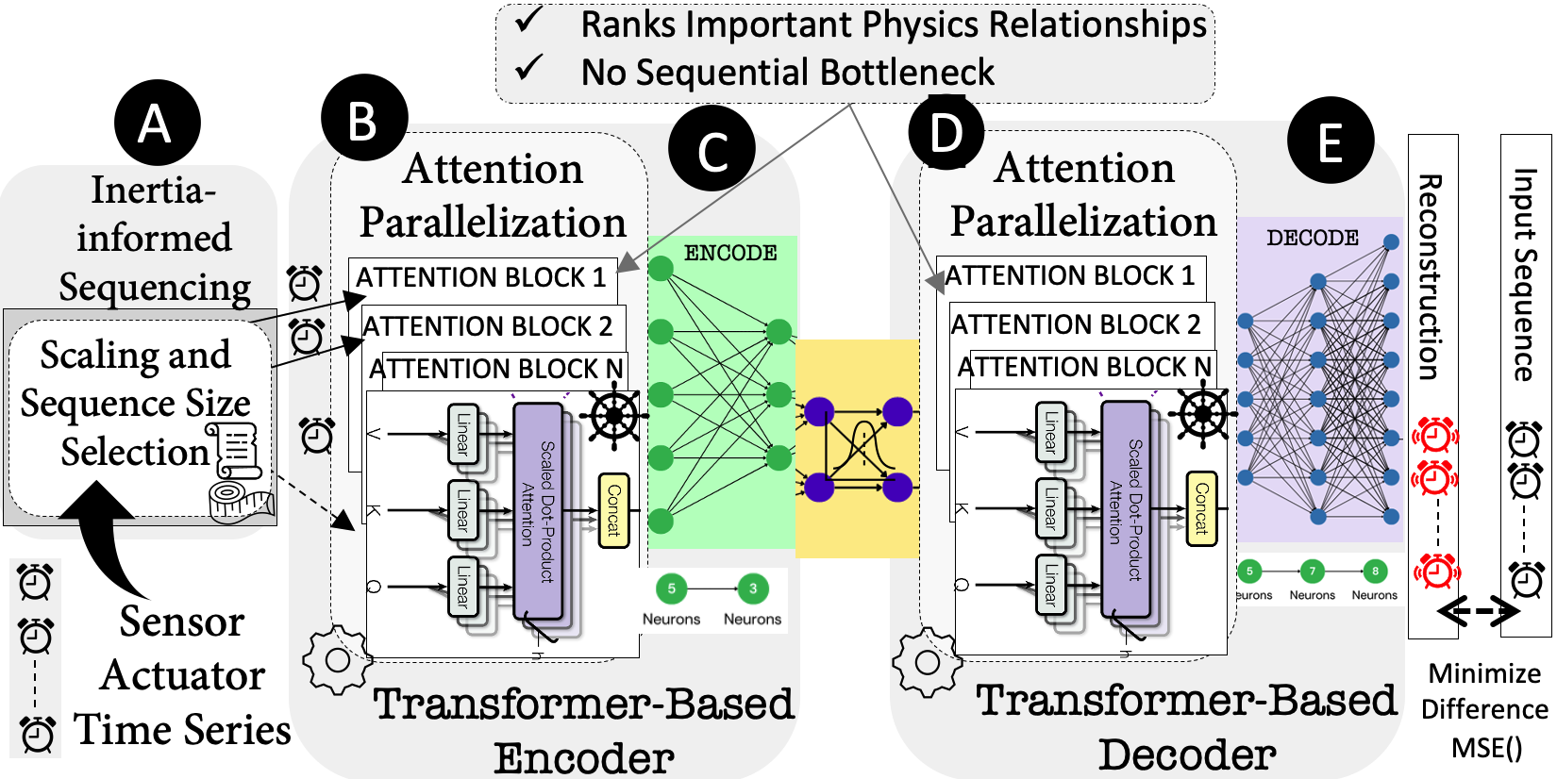
Transformer-Based Autoencoder
Reference Paper: Attention is All you Need
https://arxiv.org/abs/1706.03762
Notes:
To detect ICS attacks, existing defenses can be grouped into sensor-based, PLC-based, and host-based. Sensor-based tools are the most popular, and they work by learning normal sensor readings, such as using machine learning or physical equations, and then flag anomalous values at runtime. However, they raise high false alarms due to benign anomalies such as noise, faults, and errors.
False alarms are costly in OT, because apart from causing operator fatigue, since they may have to travel to the field to check out the alarms, false alarms can also lead to the shutdown of the plant, which may disrupt essential life services like electricity.
PLC defense can detect modified PLC logic. However, a SCADA adversary can modify PLC I/O at runtime to disrupt devices without touching the logic
Host-based defense can flag anomalous or non-SCADA Api calls. However, modern attacks can use normal APIs to perform their attacks.
In general, existing tools perform their analysis in isolation and hence lack additional context to validate their findings. For example, when sensor tools detect physical anomalies, they don’t have a way to know if it is an actual attack from SCADA, which can be helpful to rule out false alarms such as benign mal-function. The inability to do this is due to the semantic gap between SCADA execution and their physical world sensor effects.
(ADDED)
1:40

Slide 18



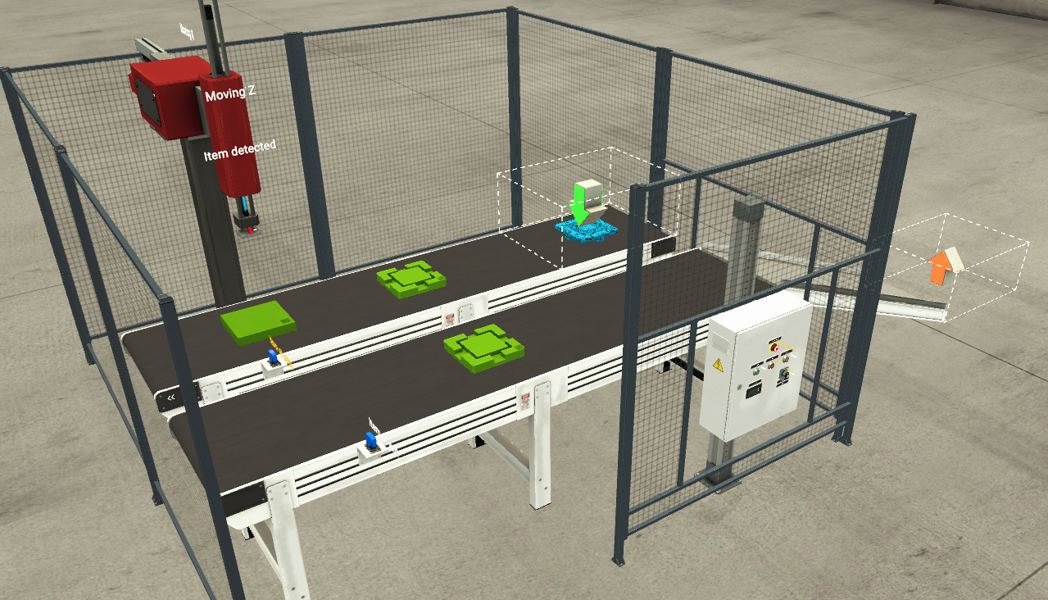
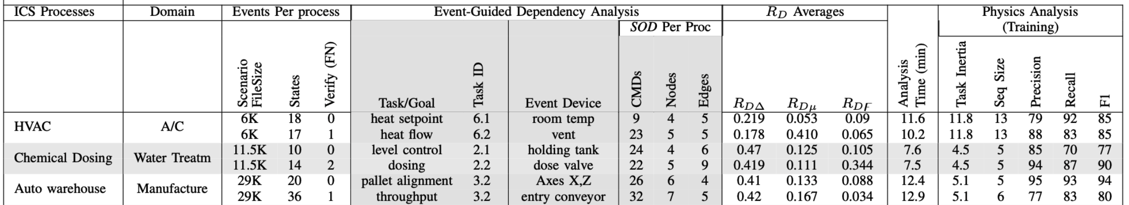
Physical Experiments Emulated in FactoryIO
Notes:
To detect ICS attacks, existing defenses can be grouped into sensor-based, PLC-based, and host-based. Sensor-based tools are the most popular, and they work by learning normal sensor readings, such as using machine learning or physical equations, and then flag anomalous values at runtime. However, they raise high false alarms due to benign anomalies such as noise, faults, and errors.
False alarms are costly in OT, because apart from causing operator fatigue, since they may have to travel to the field to check out the alarms, false alarms can also lead to the shutdown of the plant, which may disrupt essential life services like electricity.
PLC defense can detect modified PLC logic. However, a SCADA adversary can modify PLC I/O at runtime to disrupt devices without touching the logic
Host-based defense can flag anomalous or non-SCADA Api calls. However, modern attacks can use normal APIs to perform their attacks.
In general, existing tools perform their analysis in isolation and hence lack additional context to validate their findings. For example, when sensor tools detect physical anomalies, they don’t have a way to know if it is an actual attack from SCADA, which can be helpful to rule out false alarms such as benign mal-function. The inability to do this is due to the semantic gap between SCADA execution and their physical world sensor effects.
(ADDED)
1:40

Slide 19

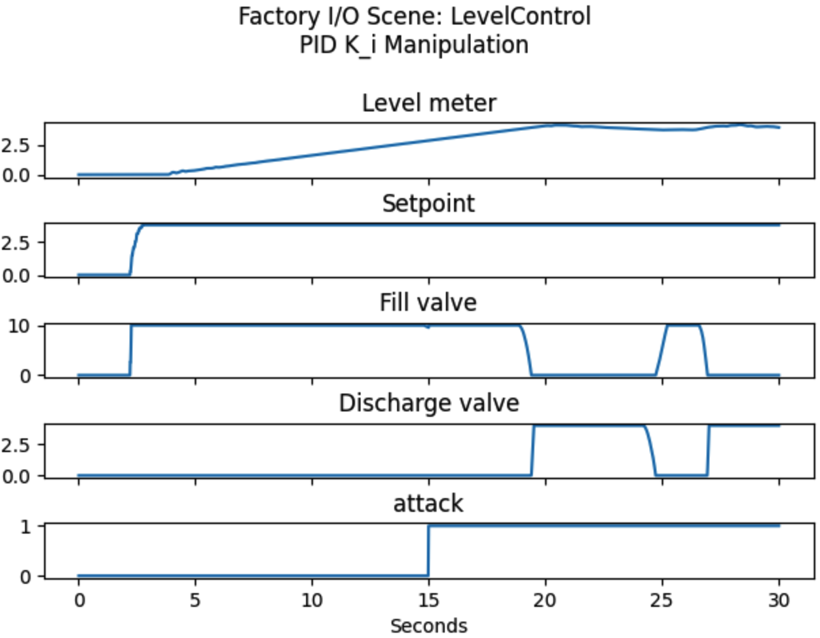

SCADA Attack Injection STUXNET-type Infection of ScadaBR
Clone the ScadaBR repository.
(https://github.com/ScadaBR/ScadaBR)
Restart ScadaBR. The attack will be activated when the right physical conditions exist. The attack log will be created in C:\Program Files\ScadaBR\tomcat\logs\AttackLog.txt.
Modify ModbusDataSource.java, and re-compile → ModbusDataSource.class. The attack source code can be found in Attack_Scripts/ModbusDataSource.java.
ModbusDataSource.class will read a Stuxnet-type attack config file to perform attack in Files\ScadaBR\tomcat\conf\AttackConfig.txt
Physical Effect
Tank
Spill over
Replace the compiled ModbusDataSource.class with the current installed ScadaBR file C:\Program Files\ScadaBR\tomcat\webapps\ScadaBR\WEB-INF\classes\com\serotonin\mango\rt\dataSource\modbus\ModbusDataSource.class.
~ 5 sec
Notes:
To detect ICS attacks, existing defenses can be grouped into sensor-based, PLC-based, and host-based. Sensor-based tools are the most popular, and they work by learning normal sensor readings, such as using machine learning or physical equations, and then flag anomalous values at runtime. However, they raise high false alarms due to benign anomalies such as noise, faults, and errors.
False alarms are costly in OT, because apart from causing operator fatigue, since they may have to travel to the field to check out the alarms, false alarms can also lead to the shutdown of the plant, which may disrupt essential life services like electricity.
PLC defense can detect modified PLC logic. However, a SCADA adversary can modify PLC I/O at runtime to disrupt devices without touching the logic
Host-based defense can flag anomalous or non-SCADA Api calls. However, modern attacks can use normal APIs to perform their attacks.
In general, existing tools perform their analysis in isolation and hence lack additional context to validate their findings. For example, when sensor tools detect physical anomalies, they don’t have a way to know if it is an actual attack from SCADA, which can be helpful to rule out false alarms such as benign mal-function. The inability to do this is due to the semantic gap between SCADA execution and their physical world sensor effects.
(ADDED)
1:40

Slide 20
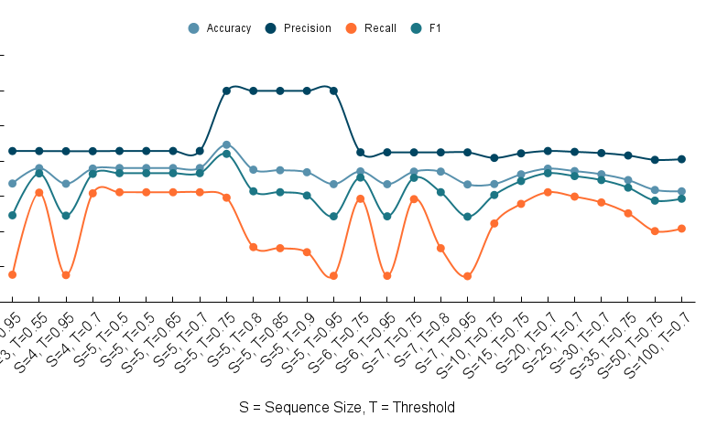
Preliminary Results Inertia-Informed sequence sizes
Sequence size of 5 had overall best performance
Notes:
To detect ICS attacks, existing defenses can be grouped into sensor-based, PLC-based, and host-based. Sensor-based tools are the most popular, and they work by learning normal sensor readings, such as using machine learning or physical equations, and then flag anomalous values at runtime. However, they raise high false alarms due to benign anomalies such as noise, faults, and errors.
False alarms are costly in OT, because apart from causing operator fatigue, since they may have to travel to the field to check out the alarms, false alarms can also lead to the shutdown of the plant, which may disrupt essential life services like electricity.
PLC defense can detect modified PLC logic. However, a SCADA adversary can modify PLC I/O at runtime to disrupt devices without touching the logic
Host-based defense can flag anomalous or non-SCADA Api calls. However, modern attacks can use normal APIs to perform their attacks.
In general, existing tools perform their analysis in isolation and hence lack additional context to validate their findings. For example, when sensor tools detect physical anomalies, they don’t have a way to know if it is an actual attack from SCADA, which can be helpful to rule out false alarms such as benign mal-function. The inability to do this is due to the semantic gap between SCADA execution and their physical world sensor effects.
(ADDED)
1:40

Slide 21
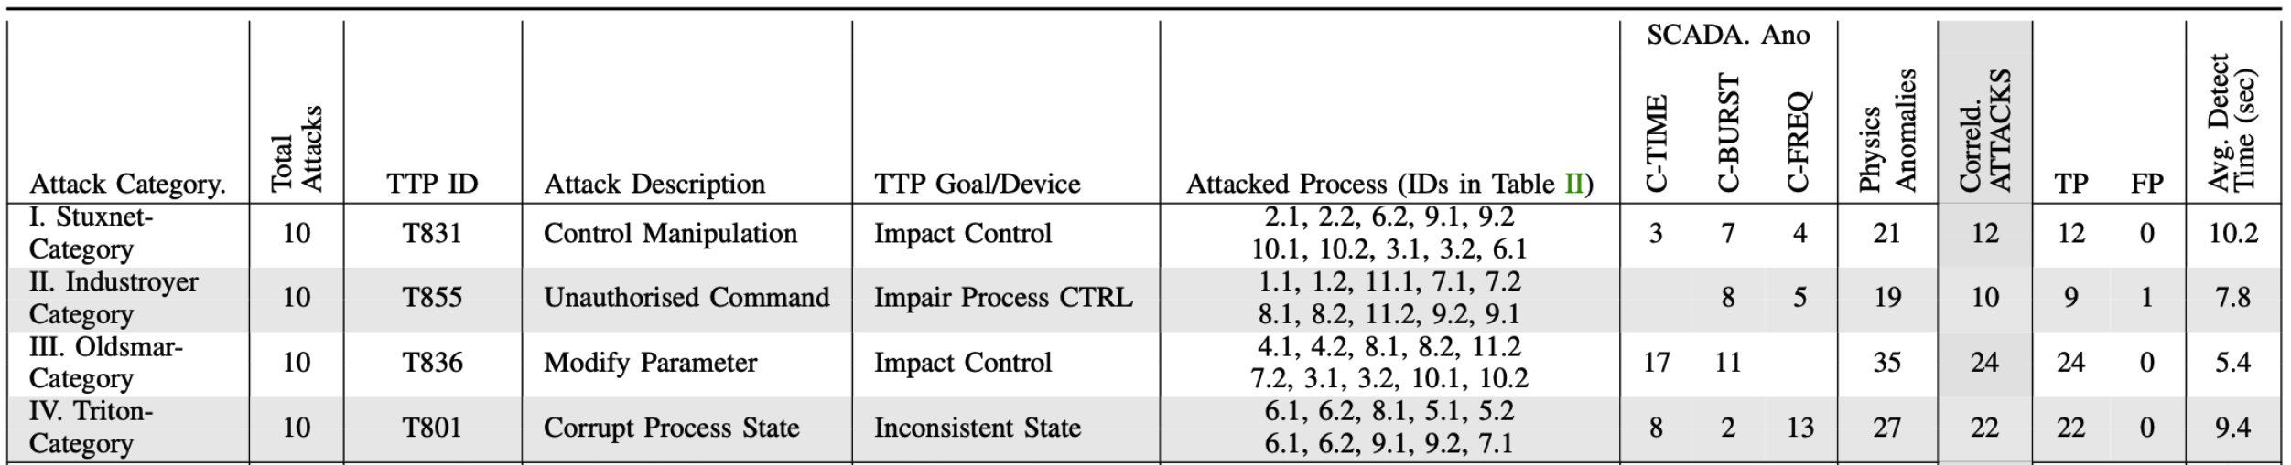
Preliminary Results Anomaly Correlation
Notes:
To detect ICS attacks, existing defenses can be grouped into sensor-based, PLC-based, and host-based. Sensor-based tools are the most popular, and they work by learning normal sensor readings, such as using machine learning or physical equations, and then flag anomalous values at runtime. However, they raise high false alarms due to benign anomalies such as noise, faults, and errors.
False alarms are costly in OT, because apart from causing operator fatigue, since they may have to travel to the field to check out the alarms, false alarms can also lead to the shutdown of the plant, which may disrupt essential life services like electricity.
PLC defense can detect modified PLC logic. However, a SCADA adversary can modify PLC I/O at runtime to disrupt devices without touching the logic
Host-based defense can flag anomalous or non-SCADA Api calls. However, modern attacks can use normal APIs to perform their attacks.
In general, existing tools perform their analysis in isolation and hence lack additional context to validate their findings. For example, when sensor tools detect physical anomalies, they don’t have a way to know if it is an actual attack from SCADA, which can be helpful to rule out false alarms such as benign mal-function. The inability to do this is due to the semantic gap between SCADA execution and their physical world sensor effects.
(ADDED)
1:40

Slide 22
Thank you Questions
Notes:
To detect ICS attacks, existing defenses can be grouped into sensor-based, PLC-based, and host-based. Sensor-based tools are the most popular, and they work by learning normal sensor readings, such as using machine learning or physical equations, and then flag anomalous values at runtime. However, they raise high false alarms due to benign anomalies such as noise, faults, and errors.
False alarms are costly in OT, because apart from causing operator fatigue, since they may have to travel to the field to check out the alarms, false alarms can also lead to the shutdown of the plant, which may disrupt essential life services like electricity.
PLC defense can detect modified PLC logic. However, a SCADA adversary can modify PLC I/O at runtime to disrupt devices without touching the logic
Host-based defense can flag anomalous or non-SCADA Api calls. However, modern attacks can use normal APIs to perform their attacks.
In general, existing tools perform their analysis in isolation and hence lack additional context to validate their findings. For example, when sensor tools detect physical anomalies, they don’t have a way to know if it is an actual attack from SCADA, which can be helpful to rule out false alarms such as benign mal-function. The inability to do this is due to the semantic gap between SCADA execution and their physical world sensor effects.
(ADDED)
1:40

